Slide 1
Синус и косинус.
Тангенс и котангенс

Slide 2


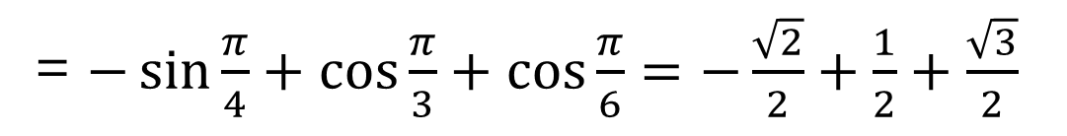
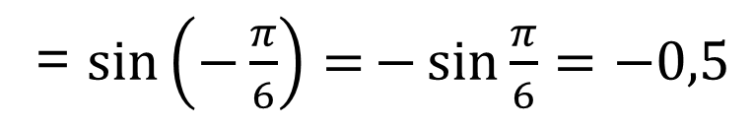
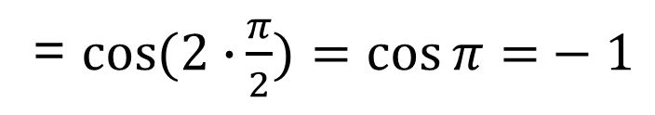
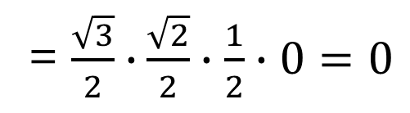
= $−\sin{\frac{π}{4}+\cos{\frac{π}{3}+\cos{\frac{π}{6}=−\frac{\sqrt{2}}{2}+\frac{1}{2}+\frac{\sqrt{3}}{2}}}}$
= $\frac{\sqrt{3}}{2}∙{\frac{\sqrt{2}}{2}∙\frac{1}{2}∙0=0}$
= $\cos{(2∙}{\frac{π}{2})=\cos{π=}−1}$
= $\sin\left(−\frac{π}{6}\right)={−\sin{\frac{π}{6}}}{=−0,5}$

Slide 3

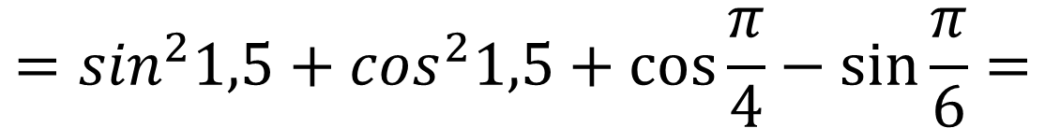
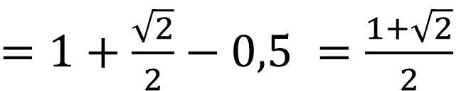
$$=\sin^{2}1,5+\cos^{2}1,5+\cos{\frac{π}{4}−\sin{\frac{π}{6}=}}$$
$=1+\frac{\sqrt{2}}{2}−0,5 =\frac{1+\sqrt{2}}{2}$

Slide 4

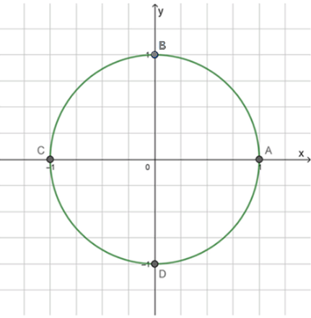
0
0

Slide 5

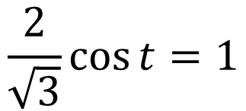
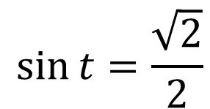


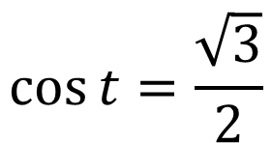
$$1−\sqrt{2}\sin{t=0}$$
$$\frac{2}{\sqrt{3}}\cos{t=1}$$
$$− \sqrt{2}\sin{t=−1}$$
$$\cos{t=\frac{\sqrt{3}}{2}}$$
$$\sin{t=\frac{\sqrt{2}}{2}}$$
0
0

Slide 6



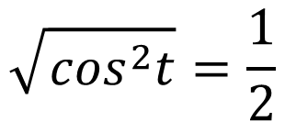



$$\sin{t=1}$$
$$\sin{t=−1}$$
$$\sqrt{\cos^{2}t}=\frac{1}{2}$$
$$\cos{t}|=1$$
$$\cos{t=−1}$$
$$\cos{t=1}$$
0
0

Slide 7

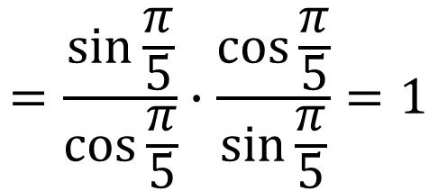
$$=\frac{\sin{\frac{π}{5}}}{\cos{\frac{π}{5}}}∙\frac{\cos{\frac{π}{5}}}{\sin{\frac{π}{5}}}=1$$

Slide 8

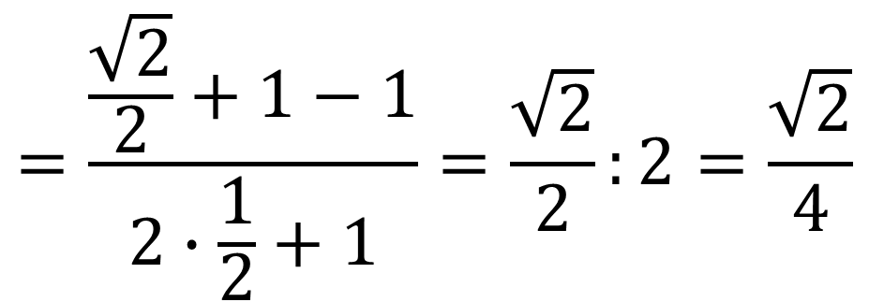
$$=\frac{\frac{\sqrt{2}}{2}+1−1}{2∙\frac{1}{2}+1}=\frac{\sqrt{2}}{2}:2=\frac{\sqrt{2}}{4}$$

Slide 9
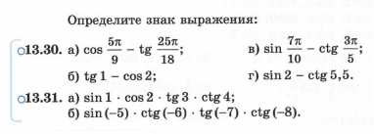
1,57
0
3,14
0
4,71

Slide 10

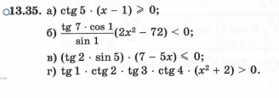





1,57
$$ctg5<0$$
0
3,14
0
x-1$≤0$
x$≤$1
4,71
>0
<0
<0
>0
$$xε(−∞;+∞)$$
$$x^{2}+2>0$$

